Slide 1
Week 2 – Web Fundamentals and Assistive Technologies
CST8914 - Accessible by Design

Slide 2
Weekly Outcome
Recall the basics of HTML, CSS, JavaScript,
Use WAI-ARIA to provide semantic meaning to the code,
Apply fixes into the code to enhance the accessibility of the code,
Underline assistive technology tools used by persons with disabilities,
Explain how screen readers deliver information to users with visual impairment
Practice the use of screen reader in accessibility testing.

Slide 3
Lesson Overview (Agenda)
In the following lesson, we will explore:
HTML
CSS
JavaScript
WAI-ARIA
Assistive technologies & screen reader testing

Slide 4
For this class you need
Code editor such as Visual Studio Code or Sublime text
Chrome browser

Slide 5
Mandatory review of technologies
It is essential that you review these technologies if needed.
Your plan of success
HTML Essential Training, Linkedin Learning, 2h 45min by Sunday of week 3
Practical CSS for No-Coders, Linkedin Learning, 2h by Sunday of week 3
JavaScript Essential Training, Linkedin Learning, 5h 29min by Sunday of week 6
jQuery Essential Training, Linkedin Learning, 3h 37min by Sunday of week 6
JavaScript quiz in class on week 7

Slide 6
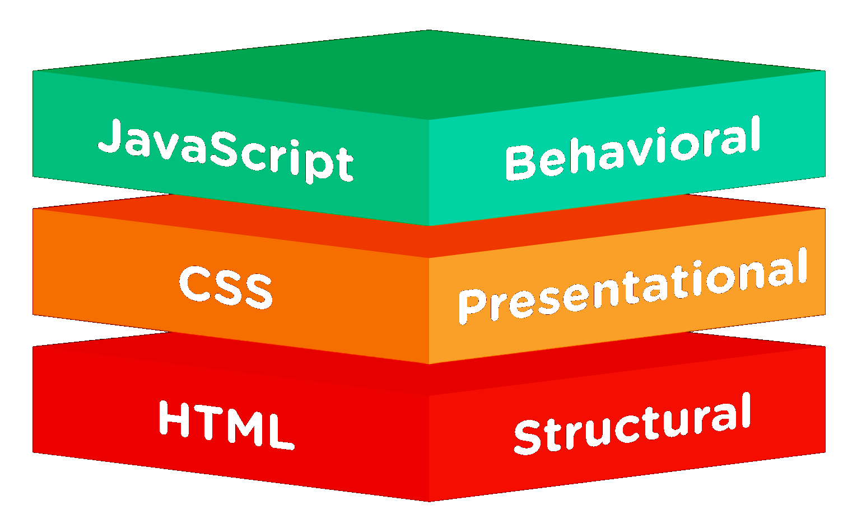
HTML, CSS & JavaScript (JS)
The 3 languages are important for accessibility:
1. HTML to define the content of web pages
2. CSS to specify the layout of web pages
3. JavaScript to program the behavior of web pages
4. WAI-ARIA when needed
Notes:
A big part of making web content accessible can be achieved by using adding correct semantic HTML.
CSS & JavaScript can significantly harm accessibility if misused.

Slide 7
Basic HTML
HTML is the foundation for making accessible content.

Slide 8
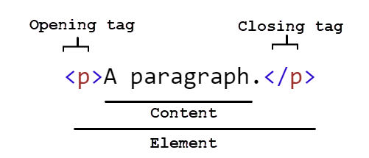
Basic HTML (Hyper Text Markup Language)
Common HTML elements
HTML is the foundation for making accessible content.
Tag | Description
<head>..</head> | Head contains machine-readable information and the <title>.
<title>..</title> | Defines the document's title
<body>..</body> | Body represents the content of an HTML document
<nav> </nav> | section to provide navigation. Other semantic sections; <header>, <main>, <footer> and <aside>
<h1>..</h1> | <h1> to <h6> are section headings
<a href=“..”></a> | creates a hyperlink
<img src=“” alt=“”/> | Embeds an image
<p>..</p> | represents a paragraph
<br/> | To make a line break
<table></table> <tr></tr> , <td>..</td> | Table, row, cell elements
<ul> </ul>, <li>..</il> | Unordered list , list item
<p>..</p> | Paragraph
<div> </div> | generic block container
<span> </span> | generic inline container
Check more tags | W3C school HTML Element Reference
HTML page structure
<!DOCTYPE html>
<html lang="en">
<head>
<title>Page title</title>
</head>
<body>
<!--structure and content here-->
</body>
</html>
Element structure
Read more W3C, HTML 5
Notes:
HTML is the foundation for making accessible content.
DIV and SPAN
DIV and SPAN are generic containers that has no semantic or style by default.
The <div> element defines a division or a section in an HTML document. The <div> element is a block-level element always starts on a new line and takes up the full width available.
The <span> element is inside a main element i.e., paragraph, heading. The <span> is an inline element that does not start on a new line.

Slide 9
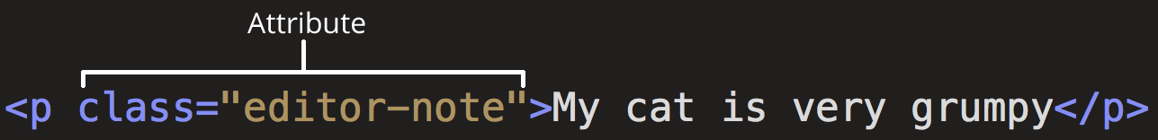
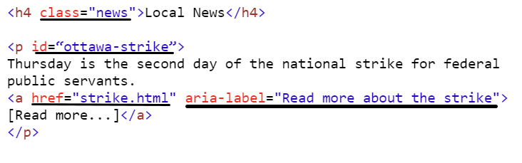
HTML attributes
HTML attributes provide additional information about HTML elements.
HTML attributes
HTML common attributes
Attribute | Description
alt | Specifies an alternative text for an image
src | URL for an image
required | An input field is required
href | URL for a link
id | Unique ID for an element
lang | Language of an element
Read more HTML Global attributes, W3School
Notes:
The id attribute of an HTML tag is used by JS to find the specific element. An id should be unique within a page to find a single, unique element.

Slide 10

Practice HTML coding
Using the https://codepen.io/Toufic-Sbeiti/pen/bNbaaeX
Add:
A link to google.ca
An image src https://adrianroselli.com/wp-content/uploads/2016/11/a11y-numeronym.png with an alt attribute alt="a11y = Accessibility
Insert a form field with a label “Customer name”
Use HTML references below to get the proper syntax
HTML standard, W3C
HTML Element Reference, W3Schools
W3C markup service
Read more HTML Global attributes, MDN
Notes:
HTML standard, W3C is the standard, use it to understand the semantic meaning of an element or see examples on how to use it properly to ensure it works well with assistive technology.
HTML Element Reference, W3Schools is a reference to look for the right syntax of an element, attribute and try its implementation. The HTML browser support section is useful to consult for new elements introduced in HTML.
W3C markup service, checks the markup validity
HTML new elements browser support

Slide 11
Demonstration: Chrome DevTools for HTML, CSS
Open Web Experience Toolkit content page https://wet-boew.github.io/themes-dist/theme-base/content-en.html and interact with the Chrome DevTools to view and edit the HTML code.
Elements
Styles
Learn more about the Chrome DevTools

Slide 12
Basic CSS
CSS is used to specify the layout of web pages. It can significantly harm accessibility if misused.

Slide 13
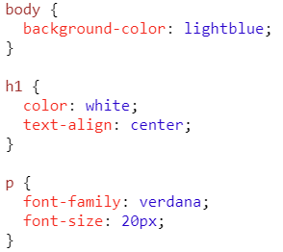
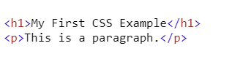
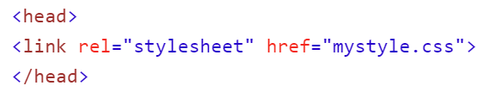
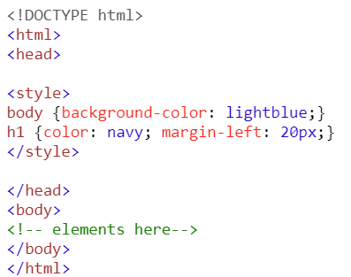
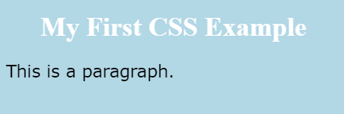
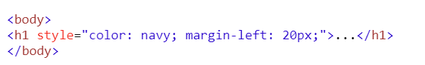
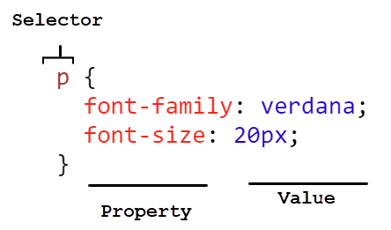
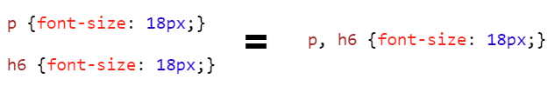
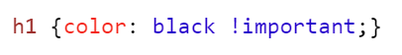
Basic CSS (Cascading Style Sheets)
CSS
Embedding styles in a page
HTML
1. External styles “mystyle.css”
2. Embedded styles in the <head>
Browser view
3. Inline Styles (on the HTML element)
Syntax
Grouping selectors
! important
Overriding ALL previous styling
Notes:
Embedding styles in a page
Style blocks override the external styles. Inline styles override the external and style blocks.
External styles is better for accessibility - Users can override your site styles based on their preference i.e. color blind etc.
(How to use a custom style sheet (CSS) with Firefox : https://www.itsupportguides.com/knowledge-base/computer-accessibility/how-to-use-a-custom-style-sheet-css-with-firefox/). It is probably easier to do it using an extension. For example, the Stylus extension is available for Firefox, with Stylish being a Chrome equivalent.
For the ease of use in the course lab activities today, we implement the embedded styles.
Use important to override styles coming from code you don’t control (such as a third-party code).

Slide 14
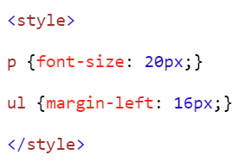
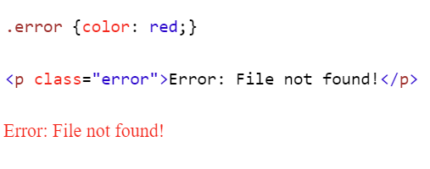
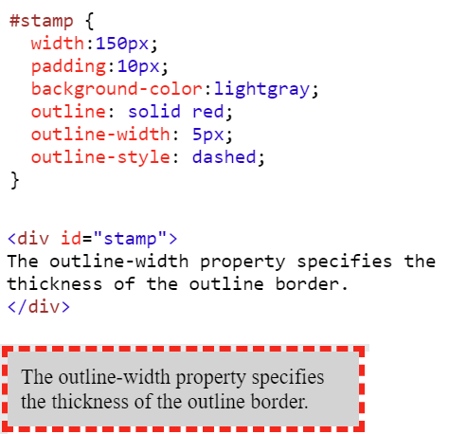
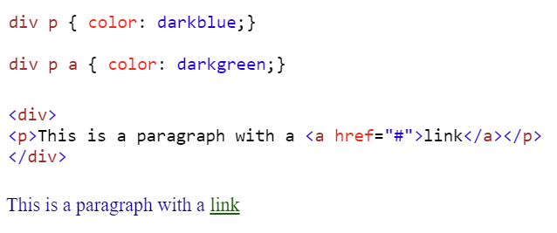
CSS selectors
Type selectors
-Based on HTML elements and applied globally
Class selectors
-Based on class attributes applied to HTML elements
ID selectors
-Based on ID attributes applied to HTML elements
CSS
CSS
HTML
Output
Descendant selector
HTML
CSS
Output
HTML
OUTPUT

Slide 15
CSS combinators
There are four different combinators in CSS:
descendant selector (space)
child selector (>)
adjacent sibling selector (+)
general sibling selector (~)
Discover the difference between the CSS combinators
Notes:
A combinator is something that explains the relationship between the selectors.

Slide 16
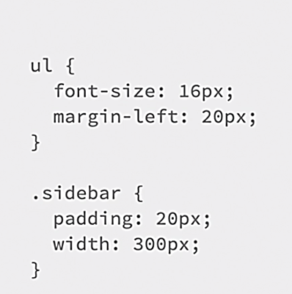
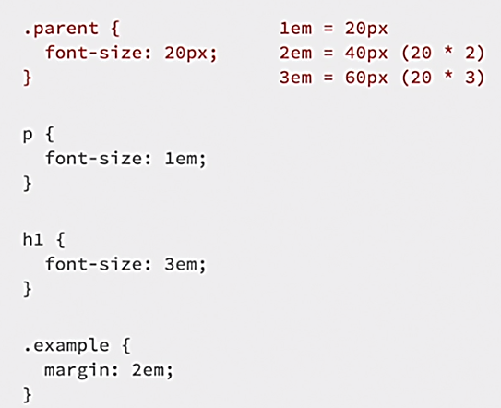
CSS units of measurement
Relative length units scale better between different rendering medium.
Learn more on Relative Lengths (CSS) from W3Schools
Absolute Length, px
Absolute (fixed) length value
Used to define height and width values
Relative Length, em
Relative value (relative to the font size of the parent element)
Value of text at its default size
Relative Length, rem
Relative value (relative to the font size of the root element, which is <html>
Only value of root is considered, not parent element
Offers more predictable control than em
Notes:
Use of relative font sizes supports people with low vision resize the text; increase text size in content so that they can read it.

Slide 17
Practice CSS styling
Using https://codepen.io/Toufic-Sbeiti/pen/bNbaaeX
Change the color of H1 and Paragraph to green.
Add a shadow to the paragraph
Add a padding to the button
Add a link and change the hover state styling (underline to dotted line)
Use CSS references below to get the proper syntax
CSS Reference, W3Schools
W3C CSS validation service
Read more HTML Global attributes, MDN

Slide 18
Basic JavaScript (JS)
JavaScript is used to program the behavior of web pages. It can significantly harm accessibility if misused.

Slide 19
Events
Events trigger actions. HTML can let events trigger actions in a browser, like starting a JavaScript when a user clicks on an element.
Example: https://www.w3schools.com/jsref/event_onclick.asp
Use...(mouse event) | ...with (keyboard event)
mousedown | keydown
mouseup | keyup
click | keypress ^{Deprecated}
mouseover | focus
mouseout | blur
Example of events
HTML - mouse and keyboard event for a custom link
<span onclick="nextPage();" onkeypress="nextPage();" role="link" tabindex="0">
<img alt="Go to next page" src="arrow.gif">
</span>
jQuery, keyboard event
$("input").keypress(function(){ $(this).hide(); });
Read more Using both keyboard and other device-specific functions
Notes:
https://www.w3.org/WAI/WCAG21/Techniques/client-side-script/SCR20.html
[1] Although click is in principle a mouse event handler, most HTML and XHTML user agents also process this event when a native HTML control (e.g. a button or a link) is activated, regardless of whether it was activated with the mouse or the keyboard. In practice, therefore, it is not necessary to duplicate this event when adding handlers to natively focusable HTML elements.
[2] Since the keypress event handler reacts to any key, the event handler function should check first to ensure the Enter key was pressed before proceeding to handle the event. Otherwise, the event handler will run each time the user presses any key, even the tab key to leave the control, and this is usually not desirable.
[3] Some mouse-specific functions (such as dblclick and mousemove) do not have a corresponding keyboard-specific function. This means that some functions may need to be implemented differently for each device (for example, including a series of buttons to execute, via keyboard, the equivalent mouse-specific functions implemented).

Slide 20
JavaScript access the DOM element
Access the DOM element:
methods like getElementById, querySelector, or querySelectorAll
Example: https://www.w3schools.com/jsref/met_document_getelementbyid.asp
Practice! Change the selector to access a class instead of ID

Slide 21
Basic WAI-ARIA

Slide 22
Accessible Rich Internet Applications (WAI-ARIA)*
WAI-ARIA are HTML attributes that define a way to make Web content and Web applications more accessible to people with disabilities.
Examples of ARIA attributes:
Roles
checkbox
slider
listbox
tablist / tab / tabpanel
Properties
aria-label
aria-labelledby
aria-describedby
States
aria-current
aria-disabled
aria-hidden
aria-pressed (toggle)
aria-checked (checkbox, radio button..)
ARIA practices https://www.w3.org/WAI/ARIA/apg/
WAI-ARIA index https://www.w3.org/WAI/ARIA/apg/example-index/
Using ARIA: Roles, states, and properties https://developer.mozilla.org/enUS/docs/Web/Accessibility/ARIA/ARIA_Techniques
Screen reader & user agent support for WAI-ARIA
* Accessible Rich Internet Applications (WAI-ARIA) also called ARIA
Read more WAI-ARIA basics
Notes:
We will explain WAI-ARIA in greater details later in the course

Slide 23
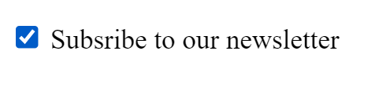
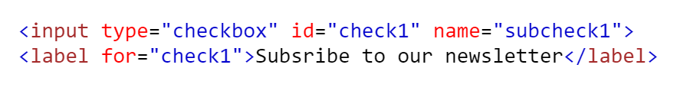
Example of checkbox: HTML
First rule of using ARIA: Use a native HTML element instead of ARIA whenever it is possible.

Slide 24
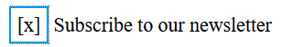
Example of custom checkbox: WAI-ARIA
Using WAI-ARIA, find the missing role, property and state for this custom checkbox to be announced properly to screen reader users
<span role=“xxx” aria-labelledby=“xxx” which state? > <span>
<label id=“c1”> Subscribe to our newsletter </label>
Use WAI-ARIA references below to get the proper ARIA to use
WAI-ARIA index https://www.w3.org/WAI/ARIA/apg/example-index/
Using ARIA: Roles, states, and properties https://developer.mozilla.org/en-US/docs/Web/Accessibility/ARIA/ARIA_Techniques
Notes:
In this case, the designer aimed a different look for the check state and therefore use of ARIA is needed!

Slide 25
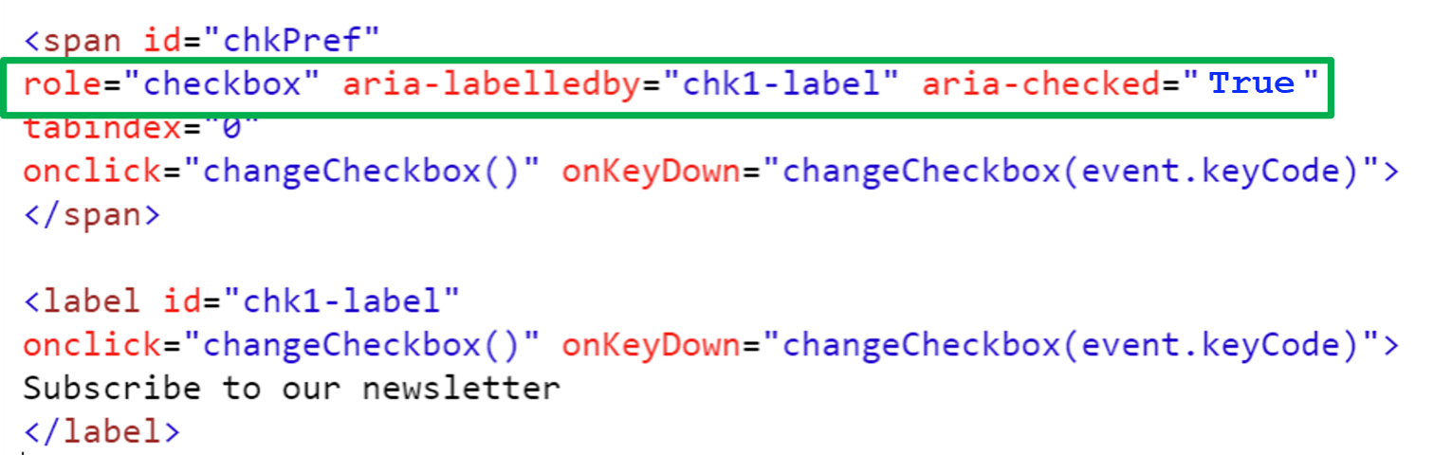
Example of custom checkbox: WAI-ARIA & JavaScript

Slide 26
WAI-ARIA & CSS
Most modern user agents support CSS attribute selectors ([CSS3-SELECTORS]), and can allow the author to create UI changes based on WAI-ARIA attribute information, reducing the amount of scripts necessary to achieve equivalent functionality.
Example
In the following example, a CSS selector is used to determine whether the text is bold and an image of a check mark is shown, based on the value of the aria-checked attribute.
[aria-checked="true"] { font-weight: bold; }
[aria-checked="true"]::before { background-image: url(checked.gif); }
Example on CodePen Aria expand collapse https://codepen.io/Toufic-Sbeiti/pen/vEBppxQ

Slide 27
Assistive Technologies and Screen Reader Testing
As a developer, you want to ensure that the future products and experiences you create support users in using assistive technologies.

Slide 28
Assistive Technologies (AT)
People with disabilities use assistive technologies to support an accessible Web experience. In the digital space, ATs can be:
No/Low-tech: head/mouth sticks, hand-held magnifiers, devices with large buttons
High-tech: voice-activated devices, eye-tracking devices, adaptive keyboards/mice
Hardware: switch buttons, ergonomic keyboards, auto-refreshing Braille device
Software: text-to-speech programs, live captions, screen readers

Slide 29
Examples of Assistive Technologies (AT)
Examples of assistive technologies :
screen magnifiers, which are used to enlarge and improve the visual readability of rendered text and images;
screen readers, which are most-often used to convey information through synthesized speech or a refreshable Braille display;
text-to-speech software, which is used to convert text into synthetic speech;
speech recognition software, which is used to allow spoken control and dictation;
alternate input technologies (including head pointers, on-screen keyboards, single switches, and sip/puff devices), which are used to simulate the keyboard;
alternate pointing devices, which are used to simulate mouse pointing and clicking.
Source: Assistive Technology (Accessible Name and Description Computation 1.1).
Notes:
Examples of AT tools https://www.deque.com/empathy-lab-online/#stations

Slide 30
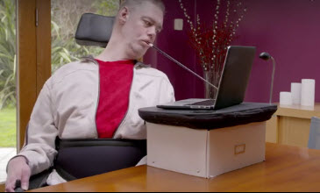
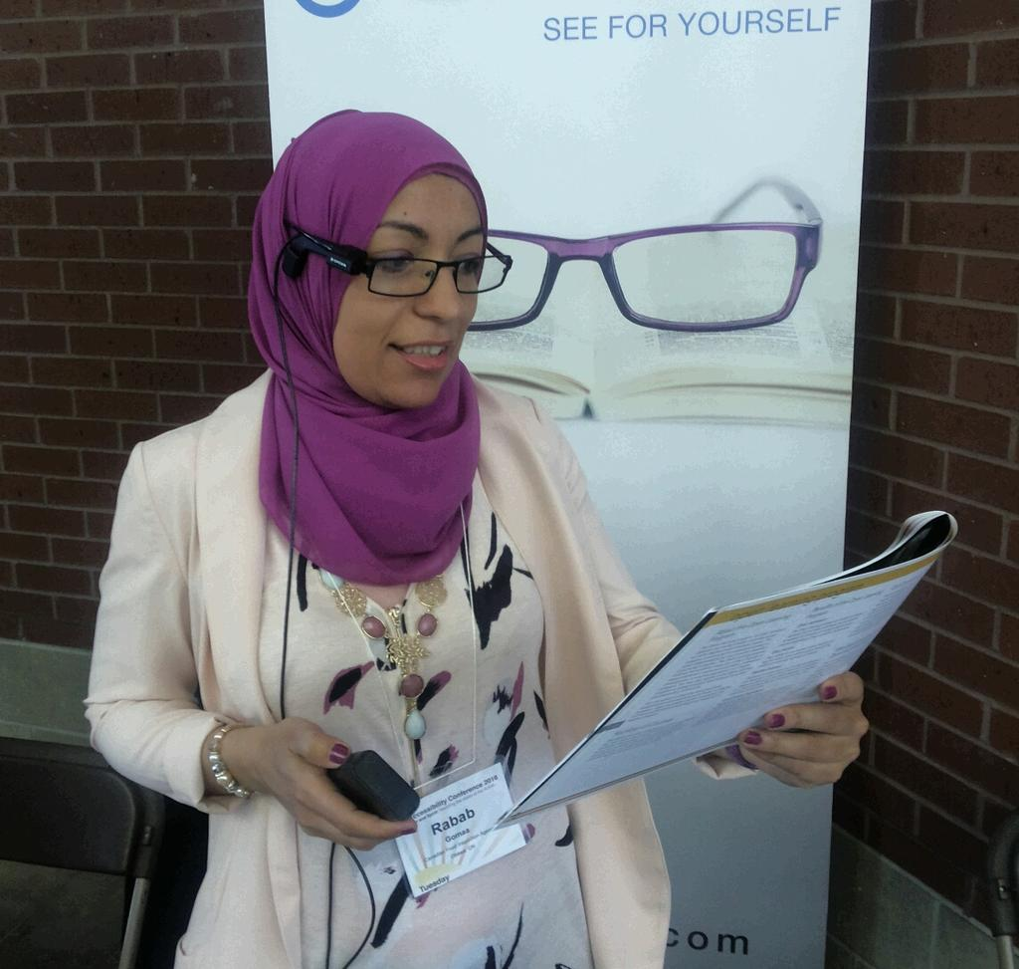
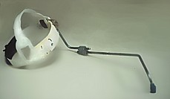
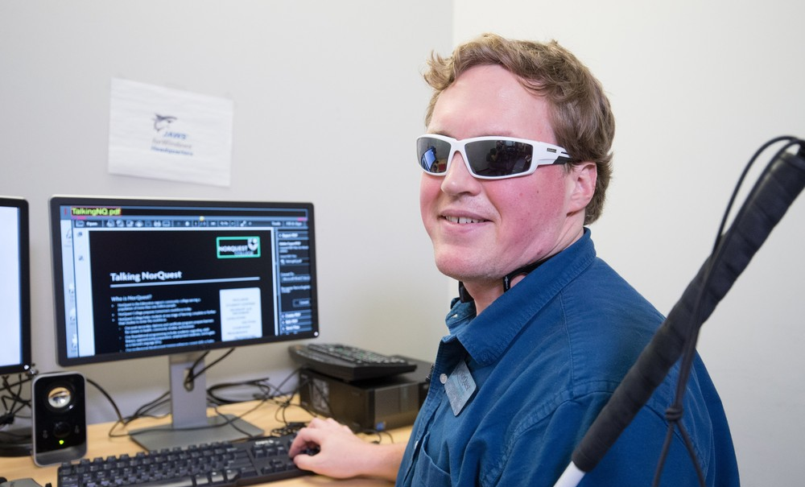
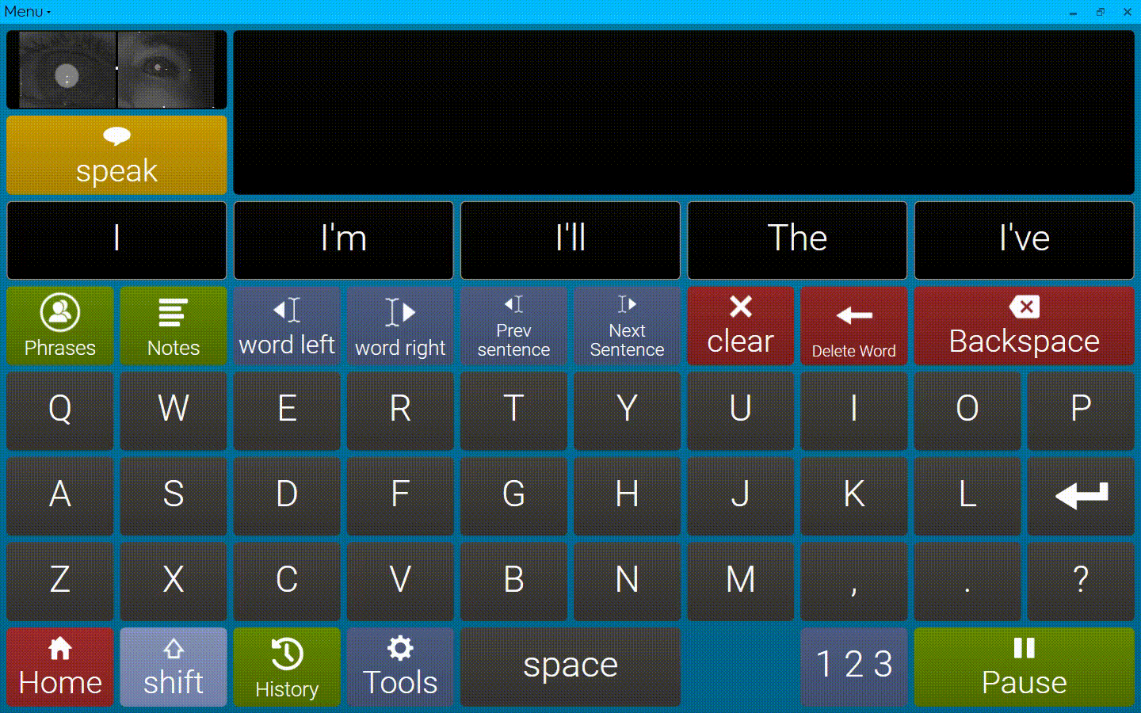
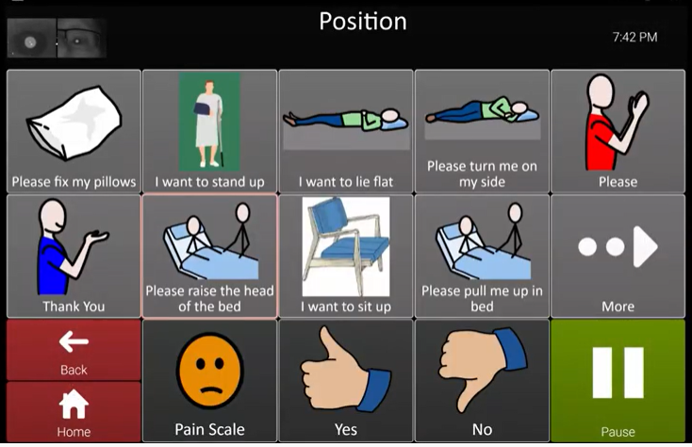
Examples of Assistive Technologies (AT) (2)
Range of mice & sticks
Artificial vision i.e., Google Glass, ORCAM
Communication devices i.e., Eyegaze
Screen readers i.e., JAWS, NVDA, VoiceOver, narrator (windows)
Adaptive strategies
Windows 11 accessibility features
macOS accessibility features
Mouse stick & Head Wand
Artificial vision devices
Screen readers
Communication devices
Notes:
Range of mice and sticks, On the screen a user using a mouse stick that has a Rubber tip to give better traction on keyboard, and the end of the stick is inserted into the user’s mouth or attached to a head wand
Artificial vision devices such as Google glass and ORCAM recognize faces and read text
Communication devices like Eyegaze allow the users with Eye movement to type in, play games and ask for medical assistance.
And finally screen readers such as Jaws, NVDA, Voiceover that converts text to speech

Slide 31
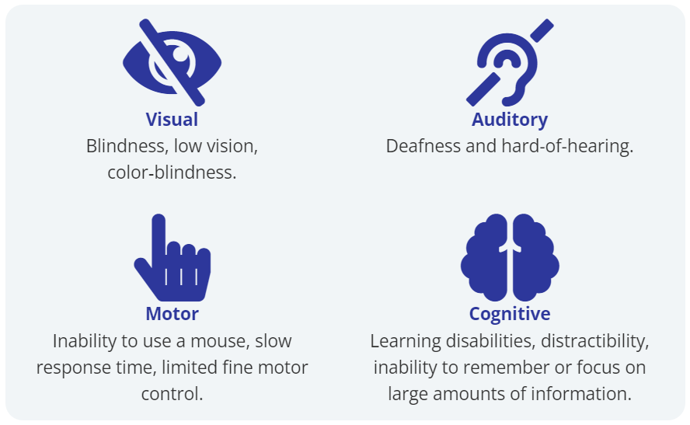

Assistive Technologies (AT) & Adaptive Strategies (1)
AT for Visual disabilities
Screen readers
Screen magnifiers & page zoom
High contrast and customized colors.
Designing for Color-blindness
Consideration: Auditory disabilities
Captions for multimedia (video & audio) content
Transcripts for all audio content.
A sign language version of the media
"Lip Reading“ for deaf people who do not use sign language.
Graphic source: People with Disabilities on the Web.
Notes:
Deafness and hard hearing
https://webaim.org/articles/auditory/culture
Deaf people who do not use sign language, use "Lip Reading“. Lip-readers are able to reliably understand about 40-60% of what others say and must fill in the blanks for the rest of the conversation.
In the real world of hard hearing people, in the absence of sign language & accurate close caption, they may prefer to use text chats. They also use a workaround a combination of automated closed caption and lip reading i.e., attending MS Teams meeting. The experience can be frustrating!

Slide 32
Assistive Technologies (AT) & Adaptive Strategies (2)
AT for motor disabilities
Eye tracking,
Voice recognition software; Dragon, Voice access on Windows (Voice access command list - Microsoft Support).
Accommodation: Cognitive Disabilities
Individuals with cognitive or learning disabilities may use a wide variety of technologies to adapt or simplify content to their needs.
Text-to-speech,
Screen readers,
Customized fonts or page colors,
Text simplification, and other techniques.
Graphic source: People with Disabilities on the Web.

Slide 33
Screen Reader Testing

Slide 34
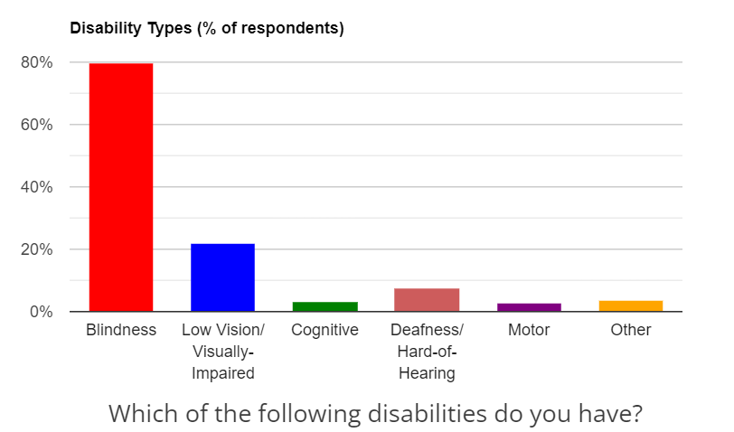
Screen readers
A screen reader is a software application which reads the underlying code of a website or app then converts text into ‘synthesized speech' speech or Braille output for the user.
Benefits:
Essential for blind and deafblind,
Beneficial for people with low vision, reading disorders, or cognitive disabilities.
Disability types - screen Reader User Survey #9 Results
https://webaim.org/projects/screenreadersurvey9/

Slide 35
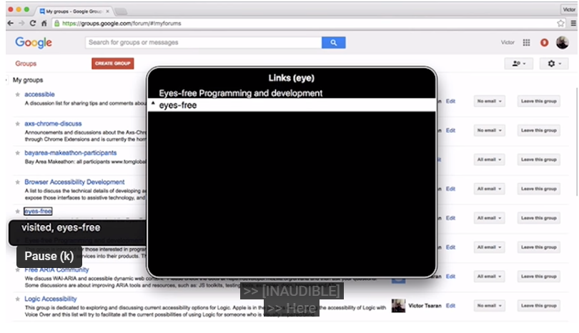
Most used screen readers
During this course, depending on the operating system you are using we will be using VoiceOver or NVDA with Chrome.
Screen reader | OS | Browser compatibility
Job Access With Speech (JAWS) | Windows | Chrome, Firefox, Edge
Non-Visual Desktop Access (NVDA) | Windows | Chrome and Firefox
Narrator | Windows | Edge
VoiceOver | macOS | Safari (also Chrome)
Orca | Linux | Firefox
TalkBack | Android | Chrome and Firefox
VoiceOver (for mobile) | iOS | Safari
ChromeVox | ChromeOS | Chrome
Demo - a blind person using VoiceOver (video , 2 min 41sec)
https://youtu.be/QW_dUs9D1oQ
Read more Screen Reader User Survey #9 Results (2021) , WebAIM

Slide 36
Screen reader testing, what to look for
When determining whether a page is accessible, you need to have 2 general questions in mind:
Interaction Can I interact with the page with a keyboard (no mouse) and a screen reader?
Proper markup for screen readers Are the page's elements properly marked up for screen readers?
Notes:
Interaction Can I interact with the page with a keyboard (no mouse) and a screen reader?
Reading/browsing content
Interacting with interactive elements (buttons and links..)
Interacting with form elements
Proper markup for screen readers Are the page's elements properly marked up for screen readers? You should expect a well-designed reader to tell you all, or at least most, of the following information about the elements it encounters.
The element's role or type, if it is specified (it should be).
The element's name, if it has one (it should).
The element's value, if it has one (it may or may not).
The element's state, e.g., whether it is enabled or disabled (if applicable).

Slide 37
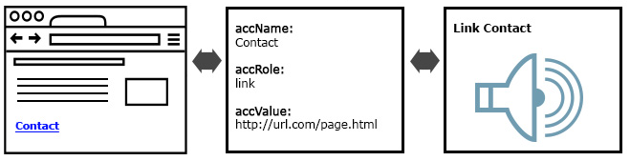
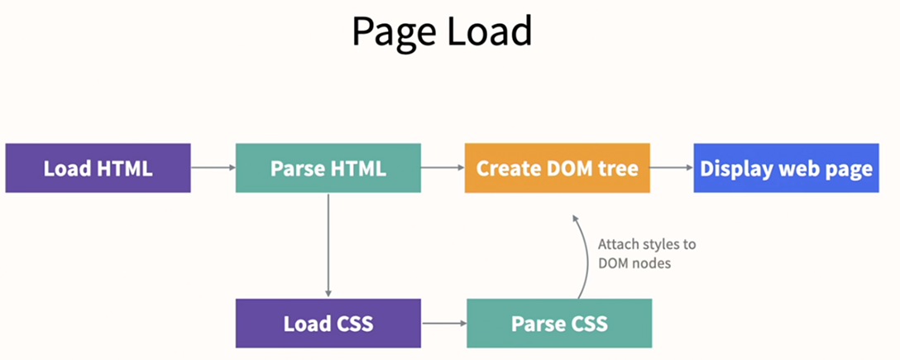
Proper markup: How screen readers work for the users
browser
accessibility tree
screen reader
Browser: Creates an accessibility tree (via DOM and JavaScript) for the webpage
Accessibility tree: Accessibility API* talks to the accessibility tree and delivers the information needed by by assistive technologies, such as screen readers.
Assistive technology: i.e., screen reader converts the information to speech and speaks it for the user
* What is the Accessibility API? Major operating system (macOS, Windows) an accessibility API. Web browsers make use of accessibility APIs to expose information for assistive technologies
Notes:
When determining whether a page is accessible, the second question in mind:
Are the page's elements properly marked up for screen readers?

Slide 38
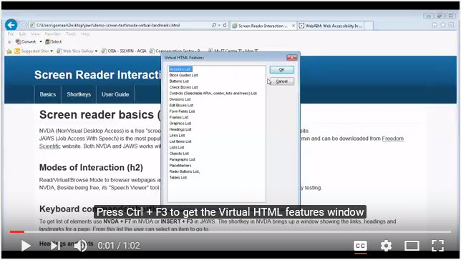
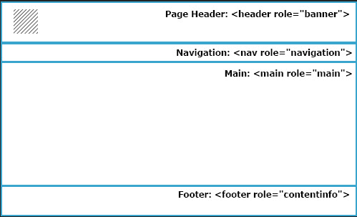
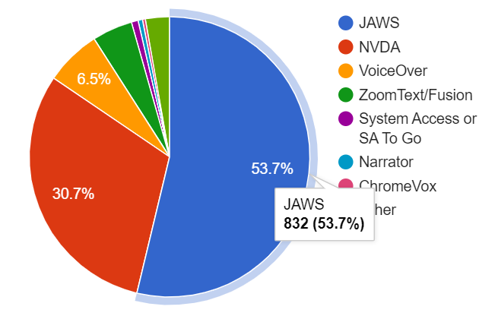
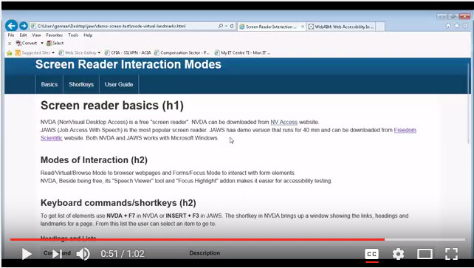
Interaction: JAWS Demos (Windows)
Virtual HTML features list
Shortcut keys / Keystrokes
JAWS demo - Virtual HTML features List https://youtu.be/Oh3RFGNbG94
JAWS is the primary desktop/laptop screen reader for 53.7% of users followed by NVDA (30.7%) then VoiceOver (6.5%)
Regions Keystroke (R) in JAWS virtual mode https://youtu.be/Oh3RFGNbG94?t=50s
Notes:
JAWS virtual HTML features list
Press Ctrl + F3 to get the Virtual HTML features window
This feature is useful when user is searching for a specific heading or finding a particular link
0:11 notice level of heading is marked beside the heading text
0:22 user moves to the selected heading
Notice, no highlight or sync in the screen. This is missing feature in JAWS (unlike NVDA focus highlight add-on)
Ways to achieve the highlight by having both Magic and JAWS together
0:26 Links list respond to press key so pressing S will go to links starting by S,
that's why one of the best practices is to start links and headings by important words. It just makes a better user experience
shortcut keys / Keystrokes
Navigate by shortkeys
Regions coded using HTML5 help screen reader users navigate easily to various sections of a page
Note: Use of corresponding WAI-ARIA roles to maximize compatibility with web browsers and assistive technologies that support WAI-ARIA but do not yet support HTML5
0:52 R keystroke jumps between header, navigation, main content and footer (content information)

Slide 39
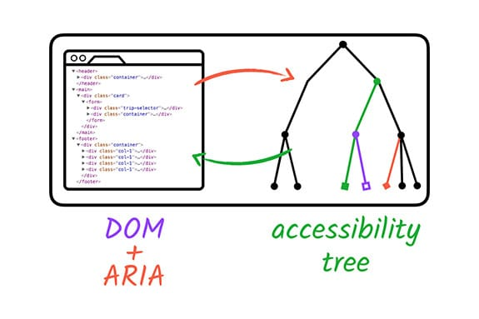
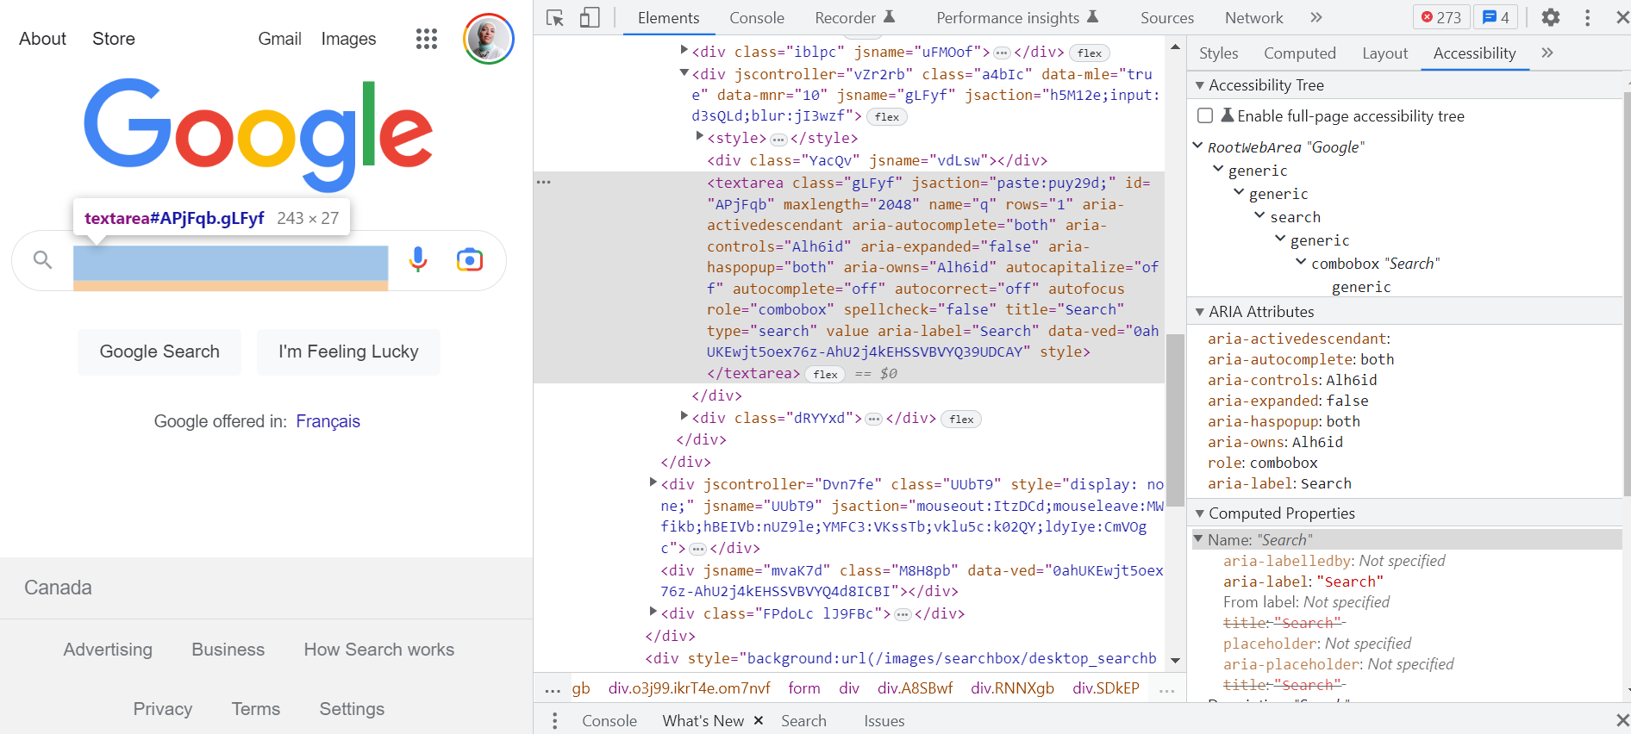
Activity: View the accessibility tree
DevTools Accessibility pane tree
What is the label and role that is delivered to assistive technology including screen readers?
Web page on Chrome
The DOM tree + ARIA
The accessibility tree
Read more Accessibility features reference - Chrome Developers
Notes:
Accessibility pane tree
Generic: Any element in the tree that doesn't have a name or has a role of generic (such as the div element) is a problem, because that element won't be available to keyboard users, or to users who are using assistive technology.
ARIA attributes ensure that screen readers have all of the information that they need in order to properly represent a page's contents
Computed Properties : Some accessibility properties are dynamically calculated by the browser. These properties are displayed in the Computed Properties section of the Accessibility tab.
Enable full page accessibility tree, see all the tree of the page (toggle the accessibility icon at the top of the DOM)

Slide 40
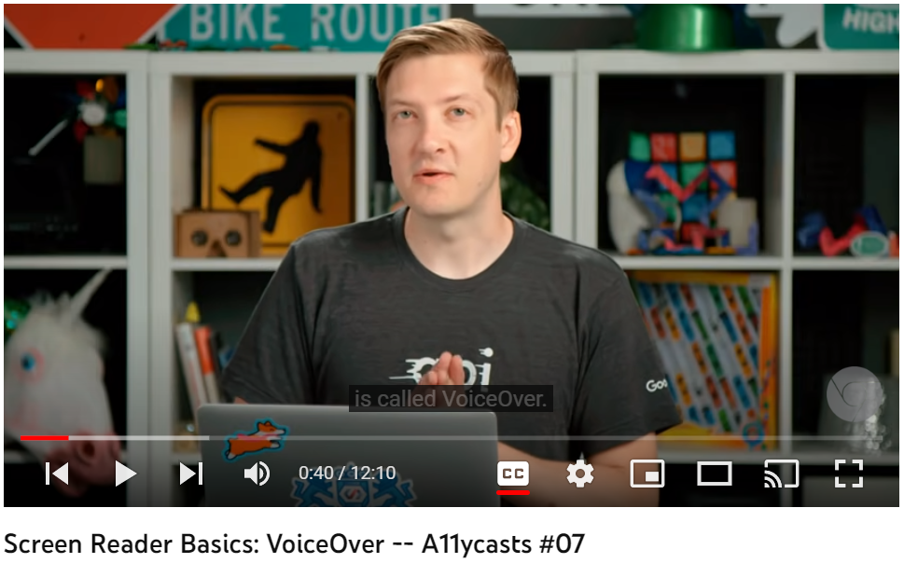
Interaction: VoiceOver (Mac)
The VoiceOver "rotor" feature helps users to do some frequently performed navigation actions quickly and easily.
How to use VoiceOver on Mac
Screen Reader Commands
Element | VoiceOver (macOS)
Start (or stop) VoiceOver | Command + F5
Command | Control + Option (VO key)
Stop audio | Control
Read next/prev | VO + → or ←
Start reading | VO + A
Element List/Rotor | VO + U
Landmarks | VO + U
Headings | VO + Command + H
Links | VO + Command + L
Form controls | VO + Command + J
Tables | VO + Command + T
Within Tables | VO + ↓ ↑ ← →
How to use VoiceOver on Mac (video,12min 10 sec)
https://youtu.be/5R-6WvAihms
Read more VoiceOver Getting Started Guide
VoiceOver Keyboard Shortcuts on a Mac - Full List, Deque University
Notes:
Watch video at home to prep for the assignment

Slide 41
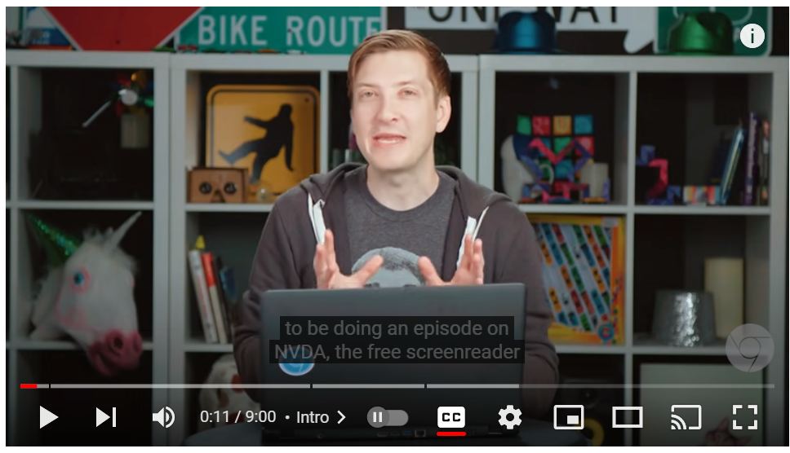
Interaction: NVDA (Windows)
User interaction modes: Virtual/Browse Mode, Forms/Focus Mode and Application Mode
How to use NVDA on Windows
Screen Reader Commands
Element | NVDA (Windows)
Exit NVDA | Insert + Q
Start NVDA | Control + Alt + N
Command | Insert (NVDA key)
Stop audio | ↓ or ↑
Read next/prev | NDVA + ↓
Start reading | NVDA + F7
Element List/Rotor | D
Landmarks | H
Headings | K
Links | F
Form controls | T
Tables | NDVA + Alt + ↓ ↑ ← →
Within Tables | Control
How to use NVDA on Windows (video, 9 min)
https://youtu.be/Jao3s_CwdRU
NVDA Keyboard Shortcuts - Full List, Deque University
Notes:
Watch video at home to prep for the assignment.
1) Virtual/Browse Mode
To read content. Users navigate content using:
Arrow keys: Move focus to the previous/next character or line instead of scrolling the page.
Virtual HTML features / List of elements / Elements Dialogue : Get a list of HTML elements in the page e.g. Ctrl+F3 in JAWS, NVDA + F7 in NVDA.
Keyboard commands / shortcut keys / Keystrokes: Navigate through HTML elements e.g. ‘h’ for headings, R for regions/ARIA landmarks.
2)Forms/Focus mode
To interact with form elements using the Forms Mode:
Pressing the tab key automatically enters/exits focus mode, a sound plays.
User navigates form elements using ‘Tab’ to go next element & ‘Shift + Tab’ to go previous element
Users can fill form fields e.g. pressing h will type a character instead of move focus to the next heading

Slide 42
Conclusion
In this lesson, we covered topics related to web fundamentals and assistive technologies.
You recalled the basics of HTML elements, attributes, the CSS selectors and properties and JavaScript syntax and event handlers. In addition, you learned about use of screen readers in accessibility testing.
In the next lesson, you will practice a variety of assistive technology tools in the Assistive Technology Lab.

Slide 43
Assignment to check your learning!
Assignment 1: Using screen reader for accessibility testing.

